Slide 1
Sudoku Solver
Siddharth Pandey

Slide 2



About Me
Current
Master student at NUS ISS Knowledge Engineering
Previous
Software engineer at Vassar Labs

Slide 3
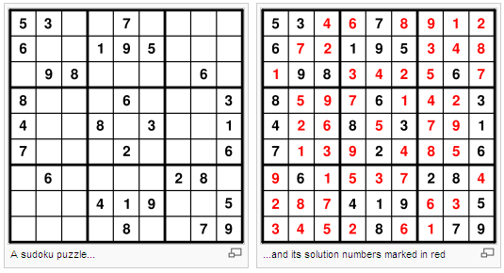
Quick Overview

Slide 4

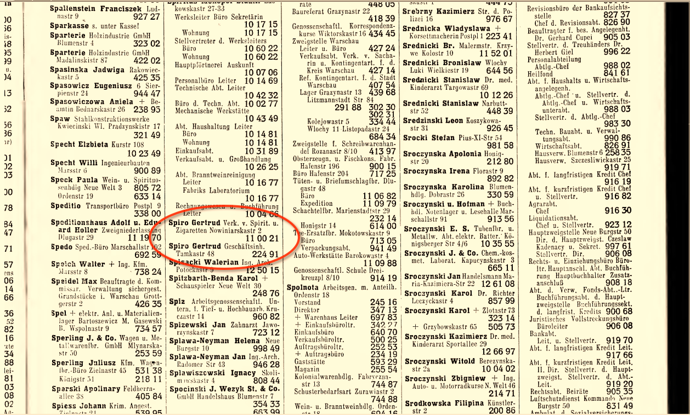
Search Problem

Slide 5
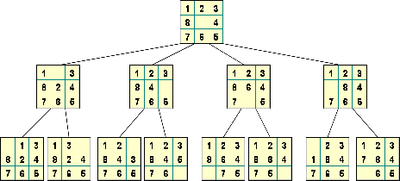
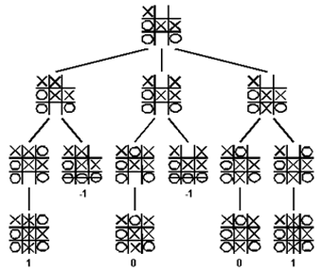
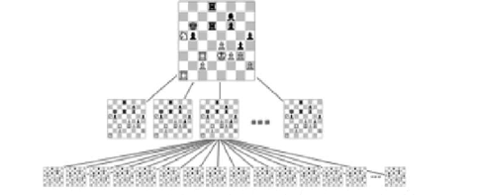
Depth First Search

Slide 6
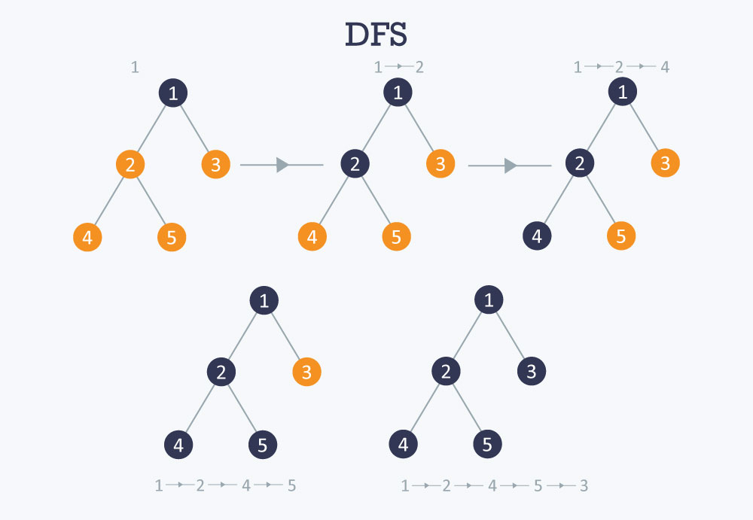
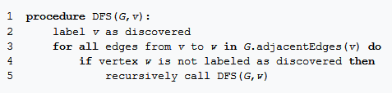
DFS Algorithm

Slide 7
DFS in Sudoku
Puzzle DFS(puzzle)
(x,y) = findSquare(puzzle) //Find square with least candidates
for i in puzzle[y][x].possibilities() //Loop through possible candidates
puzzle[y][x] = i //Assign guess
puzzle’ = DFS(puzzle) //Recursion step
if(isValidAndComplete(puzzle’)) //Check if guess lead to solution
return puzzle’
//else continue with the guessing
return null //No solution was found

Slide 8
Practical Worth
http://iwm.vassarlabs.com/rmc

Slide 9
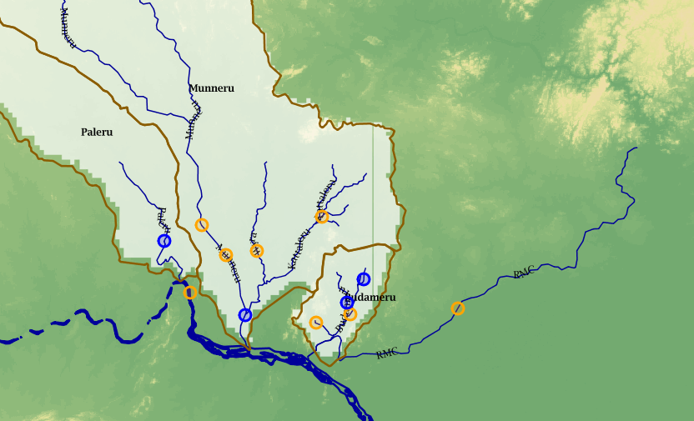
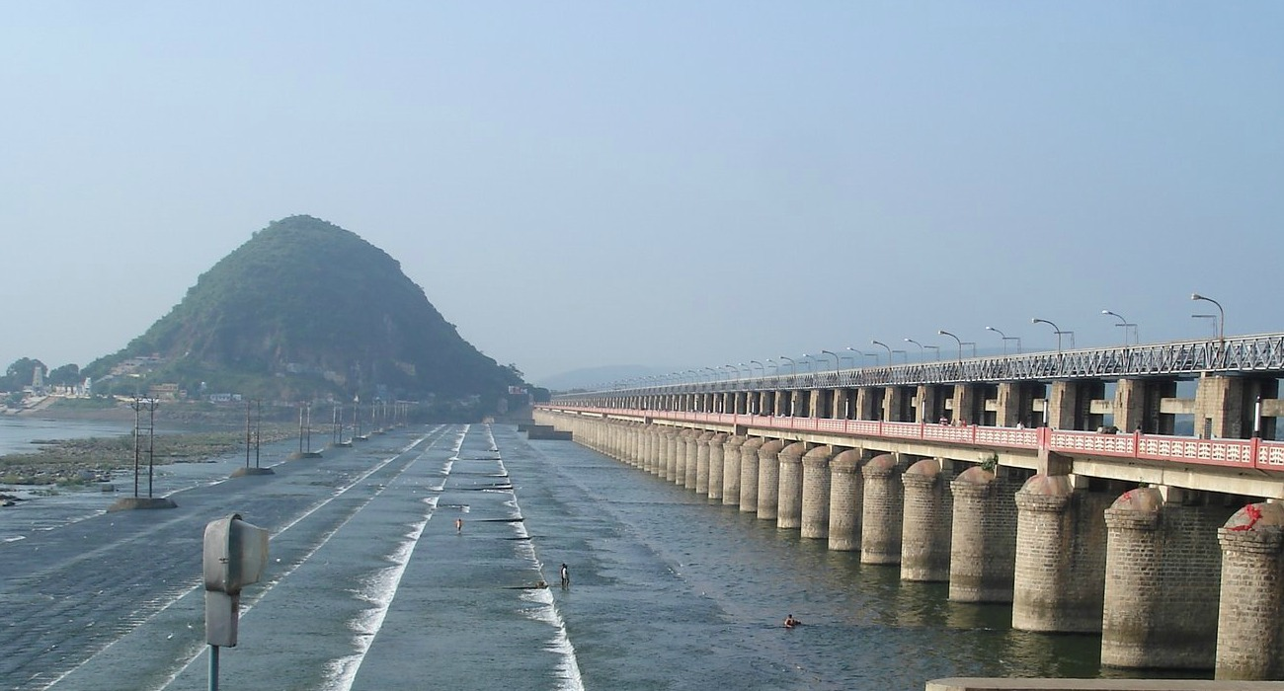
Problem
What is the total inflow to Prakasam Barrage ?

Slide 10
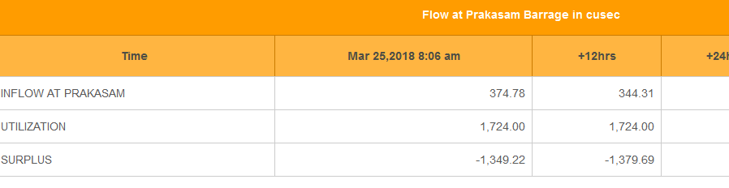
Solution
Prakasam Barrage
Location 1
Child Location 1
Child Location 2
Location 2
Child Location 1

Slide 11
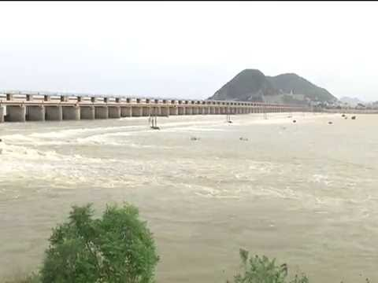
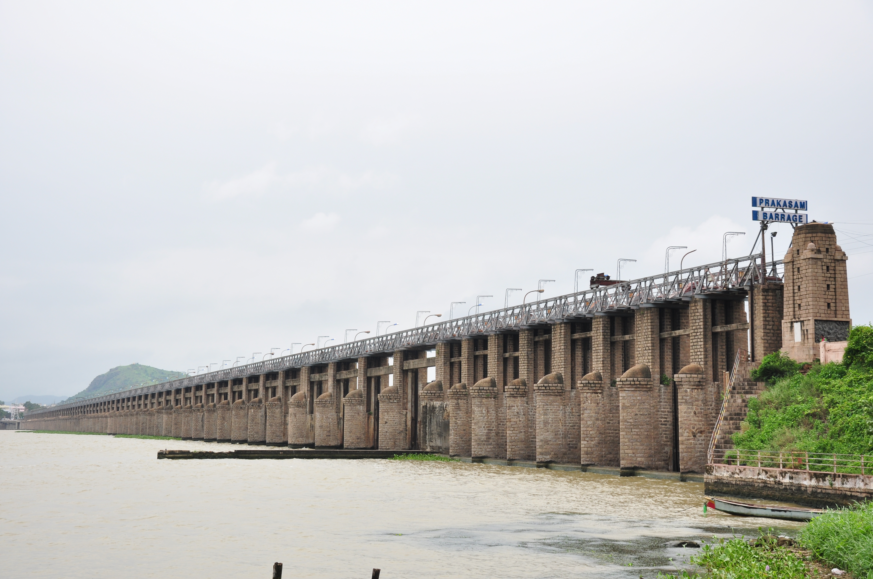
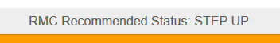
Business Value
+
=
Instantaneous flow at child rivulets
Travel time to Prakasam
Predicted flow at time tº
Helps government decide whether to step up, down or stop the inflow to barrage to suffice utilization needs and avoid flooding
High Inflow
Low Inflow

Slide 12
References and Links
https://en.wikipedia.org/wiki/Depth-first_search
https://en.wikipedia.org/wiki/Sudoku_solving_algorithms
http://www.csc.kth.se/utbildning/kth/kurser/DD143X/dkand12/Group6Alexander/final/Patrik_Berggren_David_Nilsson.report.pdf
http://iwm.vassarlabs.com/rmc
http://lipas.uwasa.fi/~timan/sudoku/

Slide 13
Code Repository
https://github.com/sidd-pandey/sudokuSolverDFS

Slide 14
Thanks!

